Slide 1
Patient Identification Strategies
RESPONDER-HF Trial
MKT1007 (short) Rev 00 2022-09

Slide 2
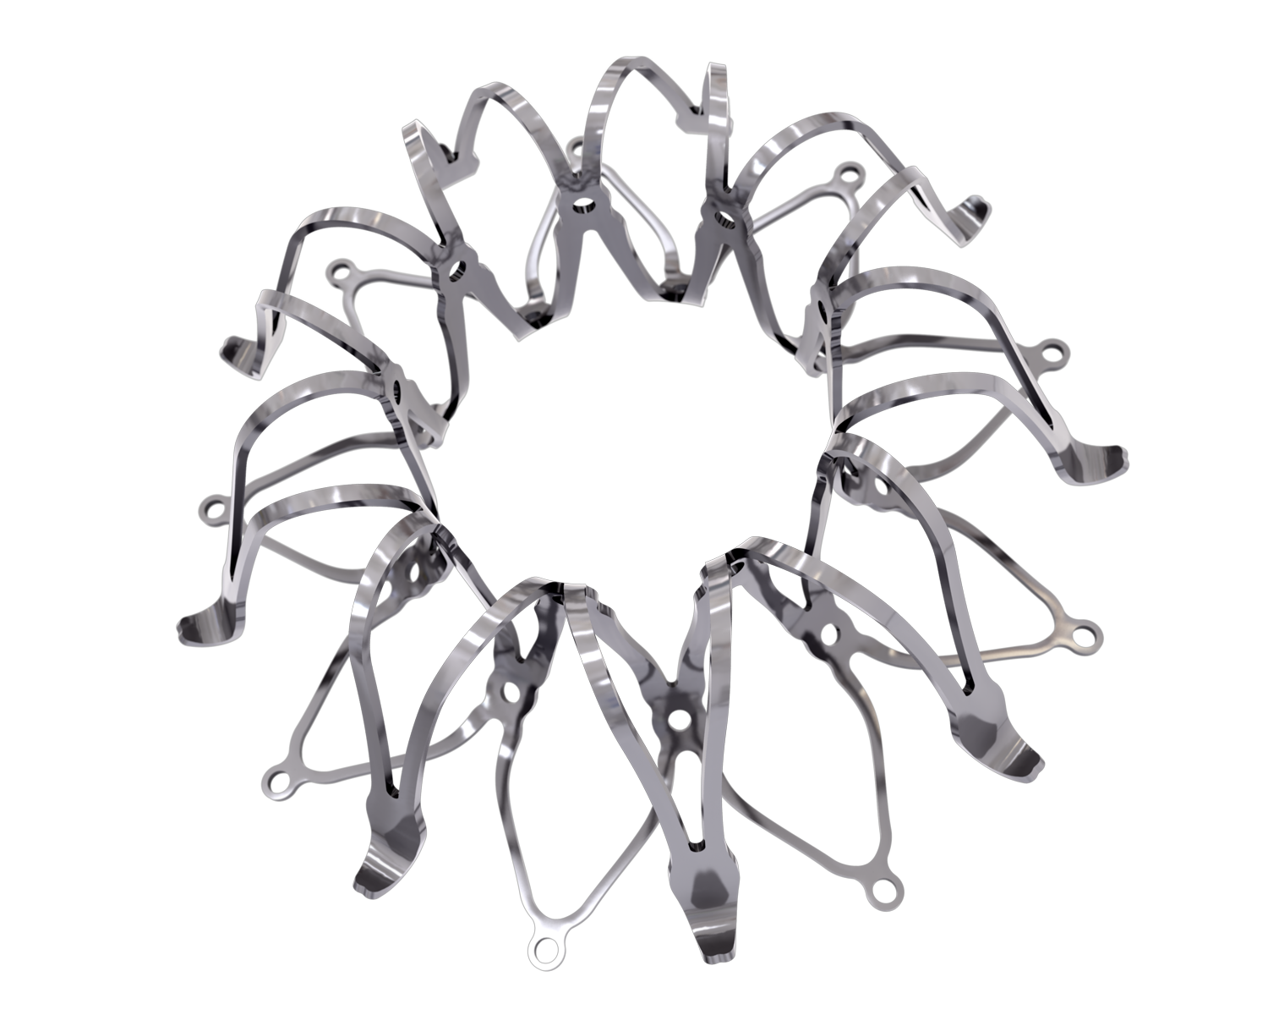
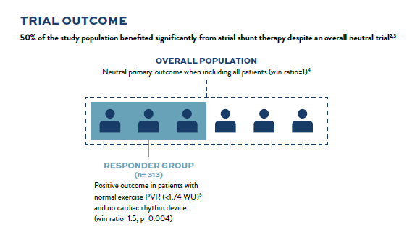




RESPONDER-HF
Confirmatory Trial to Validate efficacy of Corvia Atrial Shunt in HFpEF/HFmrEF
REDUCE LAP-HF II
50% of population benefited significantly despite overall neutral trial
RESPONDER-HF
Confirmatory trial to validate Responder Group
outcomes observed in REDUCE LAP-HF II
OVERALL POPULATION (n=626)
Neutral primary outcome (win ratio=1)
Study Design | Randomized, double-blinded, sham-controlled
Status | Enrolling Q3 ‘22
Clinical Sites | Up to 55 sites
Participants | 260 randomized 1:1
Population | HFpEF & HFmrEF (EF≥40%)
RESPONDER GROUP (n=313)
Positive outcome (win ratio=1.5, p=0.004) in patients with normal exercise PVR (<1.74 WU) and no cardiac rhythm device

Slide 3
Responder-hf
Confirmatory Trial to validate Responder Group Outcomes
PURPOSE: Confirm the clinical efficacy of the Corvia Atrial Shunt in HF patients with LVEF ≥40%, elevated left sided filling pressures, and who remain symptomatic despite optimal Guideline Directed Medical Therapy (GDMT).
Study Population
N = 260 randomized
Age ≥40, preserved RV function, exercise PCWP (≥25mm Hg) with left-to-right gradient (≥ 5mm Hg), exercise PVR <1.75 WU, no cardiac rhythm management device
Atrial Shunt Treatment
N = 130
PRIMARY COMPOSITE ENDPOINT
Rate of total HF events (first and recurrent) up to 24 months, analyzed when last randomized patient reaches 12 months
KCCQ change from baseline to 12 months
Sham Control
NN = 130
MAJOR SECONDARY ENDPOINT
Cardiovascular mortality through 12 months
*Modifications from REDUCE LAP-HF II
Cross-over to treatment allowed after 24M follow-up visit

Slide 4
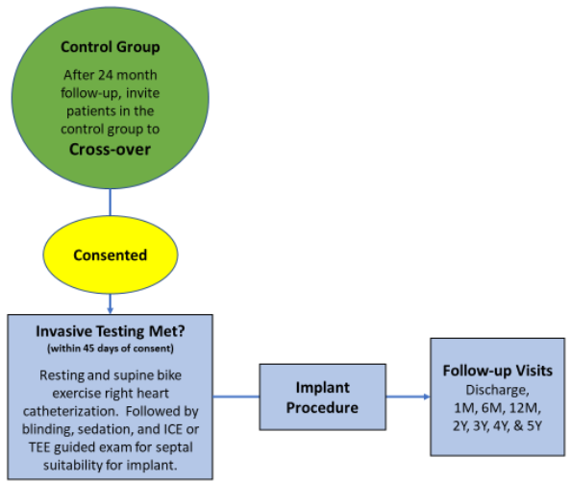
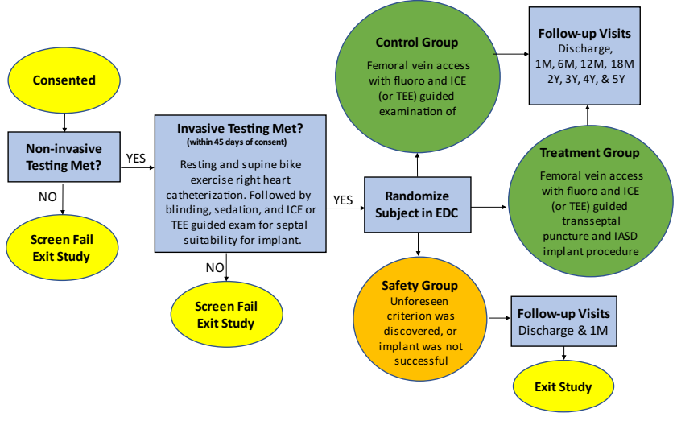
REsPONDER-HF PATIENT FLOW
Candidate screening and randomization
Control group crossover to implant @24m
the atrial septum

Slide 5
Responder-hf key inclusion criteria
History | Echo evidence | Hemodynamic evidence
Chronic symptomatic HF documented by symptoms of LV diastolic dysfunction NYHA Class II-IV (ambulatory) In prev. 12m HF hospitalization OR Intensification of oral diuresis OR Increased BNP/NT-proBNP 50 pg/ml or 150 pg/mL in NSR 150 pg/ml or 450 pg/mL in Afib GDMT for >30 days ≥40 years old | Site-determined LVEF ≥40% within the past 6m without documented EF <30% in prior 5 years Site determined echocardiographic evidence of diastolic dysfunction documented by one or more of the following: LA diameter > 4 cm; OR Diastolic LA volume > 50 or LA volume index > 28 ml/m²; OR Lateral e’ < 10 cm/s; OR e’ < 8 cm/s | Resting RAP ≤14 mmHg Exercise PCWP ≥25mmHg, & left-to-right gradient ≥5 mmHg Peak exercise PVR <1.75 Wood units

Slide 6
Responder-hf key exclusion criteria
History | Echo evidence | Hemodynamic evidence
Any implanted cardiac rhythm device Stroke, TIA, DVT, or PE within the past 6 months Cardiac intervention (i.e. PCI, PVI, CABG) within past 3 months or planned within next 3 months Currently requiring dialysis OR eGFR <25ml/min/1.73 m² BMI >45 | Presence of hemodynamically significant valve disease: Mitral valve disease defined as grade ≥3+ MR or > mild MS; OR Tricuspid valve regurgitation defined as grade ≥2+; OR Aortic valve disease defined as ≥2+ AR or > moderate AS Right ventricular dysfunction defined as: More than mild RV dysfunction as estimated by TTE; OR TAPSE <1.4 cm | Cardiac Index < 2.0 L/min/m2

Slide 7
Differences between reduce lap-hf ii & responder-hf
Potential Patient Evaluation Form | CRM devices | Hemodynamic testing
Baseline Echo recording (uploaded to the cloud) needed together with Potential Patient Evaluation Form Evaluation of the patient will be performed by independent Trial Eligibility Committee (TEC) (4 physicians available for online review) | No CRM devices | CO & PVR assessment required at each stage of exercise (Baseline, legs up, 20 W,…, Peak). Only peak determines eligibility. PVR < 1.75 WU @ peak exercise

Slide 8
HFpEF Patient Path to RESPONDER-HF TRIAL
Phase 0:
Before HFpEF identification
Phase 1 (yellow):
Patients with high potential for HFpEF
Phase 2 (orange):
Therapy candidate
Undiagnosed
HFpEF patient
“Hot Spots”
Identified
patient with
high-potential
for HFpEF
Address
volume overload,
symptoms,
& comorbidities
w/ GDMT
Perform
hemodynamic
evaluation*
(confirm HFpEF
Dx & shunt
candidacy)
Trial candidate
symptoms
continue
symptoms
relieved
Continue GDMT
No HFpEF →
seek other Dx
PVD → try other
therapy
*If not previously performed as part of HFpEF Dx

Slide 9
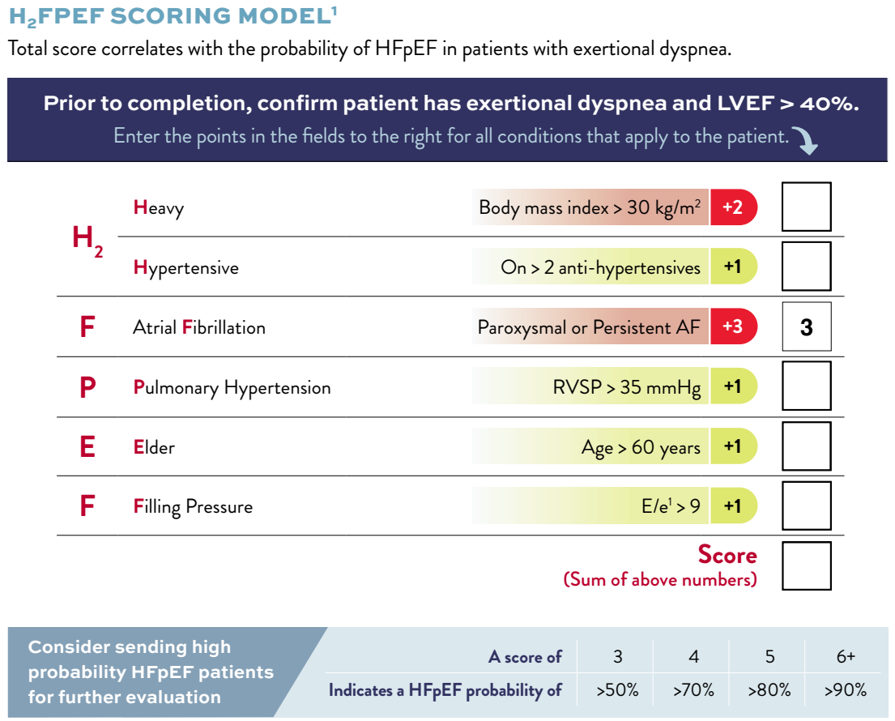
H₂FPEf score
created to simplify the identification of HFpEF patients among those with dyspnea
Total score correlates with probability of HFpEF in patients with exertional dyspnea
A score of just 4 points indicates a >70% probability of HFpEF
Certain patient populations (like AF) are highly probable for HFpEF, meaning that there are HFpEF “hotspots”
Reddy YN…Borlaug BA. Circulation 2018

Slide 10





Investigate an Undiagnosed Hfpef patient “hot spot”
Many patients with hfpef aren’t yet diagnosed, which is needed to access therapy options
Inpatients / ED Screen for: Dyspnea on exertion Atrial fibrillation HF diagnosis “Heart failure” in notes Elevated BNP / NT-proBNP Use of IV diuretics | Echo lab Screen for: Notes including “shortness of breath”, “heart failure”, “fluid overload”, “diuresis” LVEF ≥ 40% LA enlargement LV hypertrophy Septum bending or bowing into RA Elevated E/e’ Moderate or greater diastolic dysfunction | Cath / EP / Cardioversion Lab Screen for: LVEDP > 15 mmHg Elevated PCWP (≥ 15 mmHg @ rest or ≥ 25 mmHg @ exercise) Elevated mean LAP during PVI (>15 mmHG) Atrial fibrillation NYHA Class II-IV Elevated BNP / NT-proBNP Symptomatic TAVI patients | Pulmonology / PH Screen for: Unexplained dyspnea Elevated systolic PA pressure / peak TR velocity on echo (68% of ↑PASP cases are due to HFpEF¹) | Obesity / geriatric clinic Screen for unexplained: Dyspnea Leg edema or other signs of venous insufficiency Elevated systolic PA pressure on echo Elevated BNP / NT-proBNP
¹Strange G, et al. Heart 2012

Slide 11
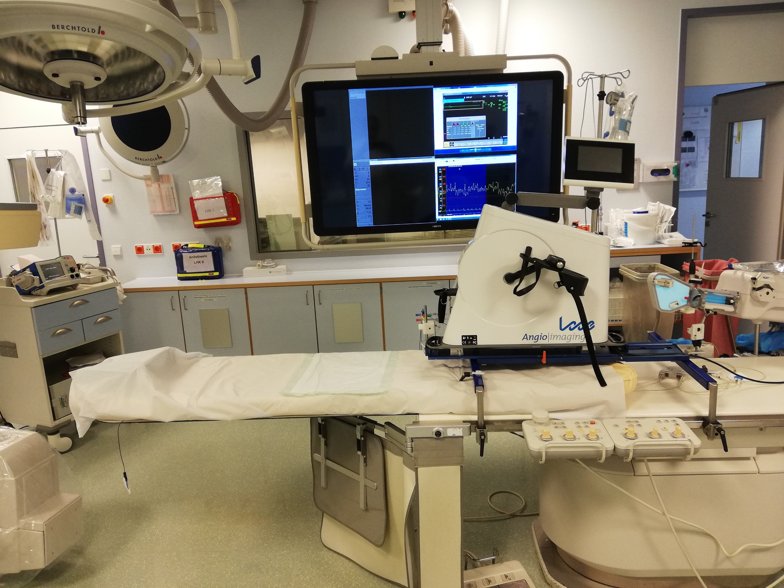
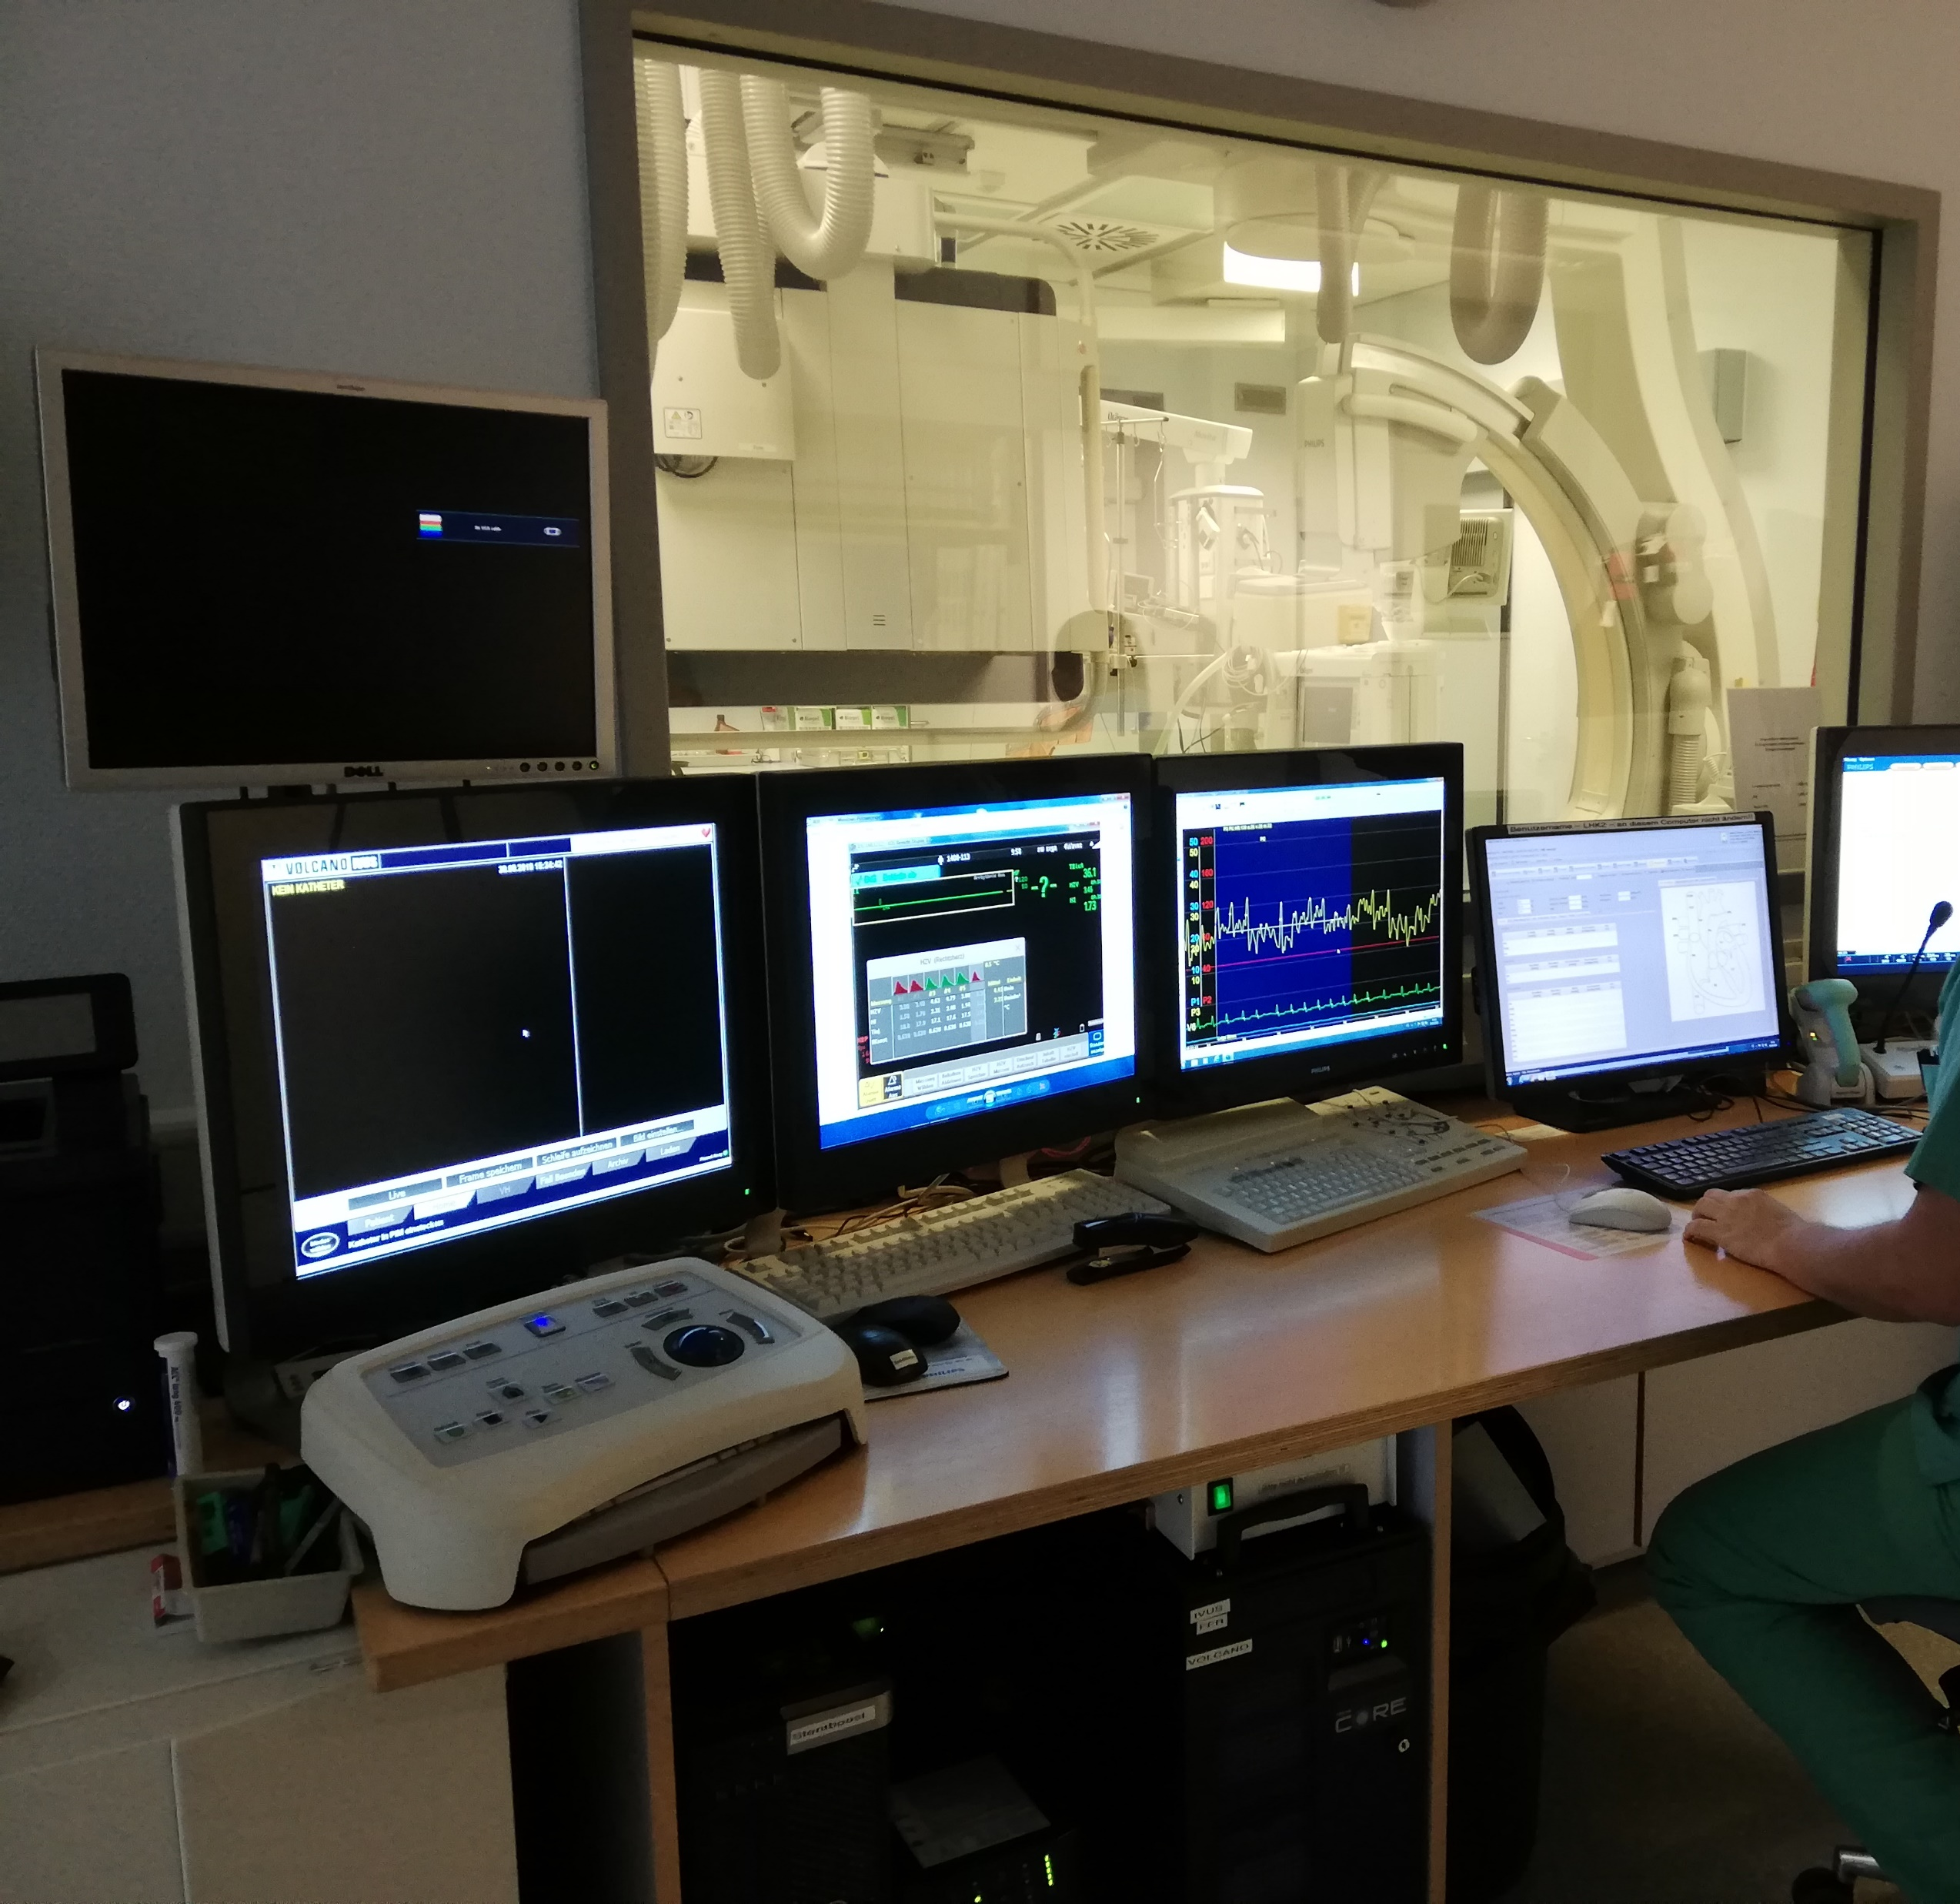
Confirm trial candidacy via hemodynamic testing
Look for significant La pressure increase, LA->RA gradient, & PVR<1.74WU @ exercise
Since some HFpEF patients only exhibit dyspnea upon exertion, exercise stress test in addition to the catheterization is required.
If exercise testing wasn’t already performed for HFpEF diagnosis, aim to identify:
RAP ≤14 mmHg@ rest
PCWP >25 mmHg during exercise
PCWP-RAP gradient of ≥5 mmHg
Peak exercise PVR <1.75 Wood units
Hemodynamic testing setup at Unfallkrankenhaus Berlin

Slide 12
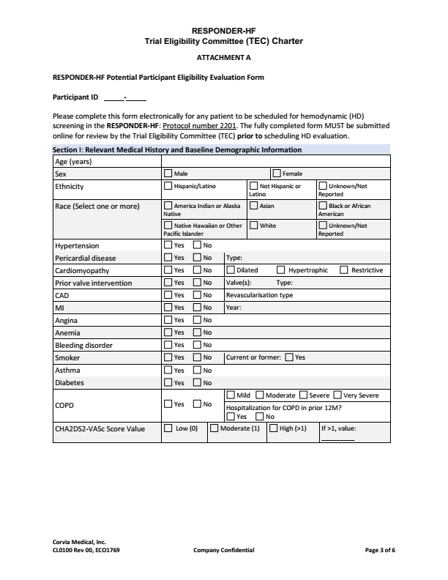
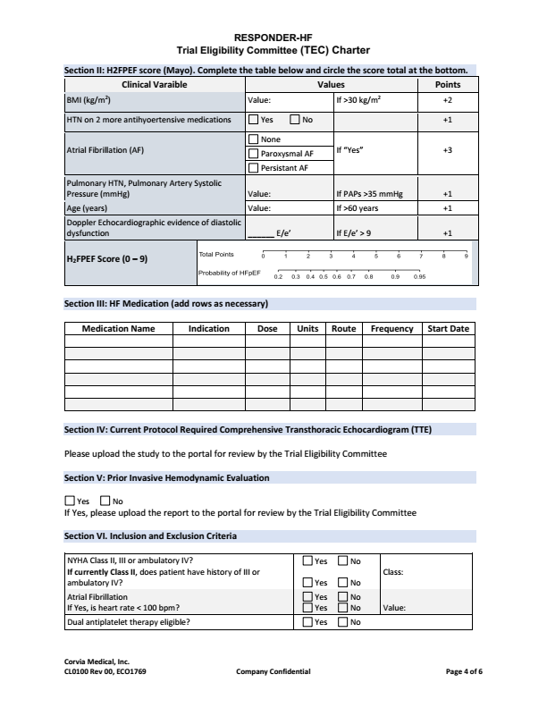
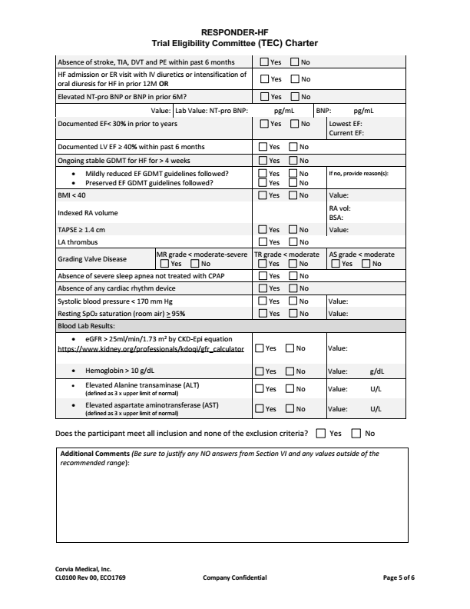
Potential patient evaluation form
For inclusion in RESPONDER-HF trial
Pg 1
Relevant medical history
Pg 2:
H2FPEF score, HF meds, TTE, HD eval
Pg 3
Inclusion / exclusion criteria
Corvia Form CL0100

Slide 13
Strategies for effective Responder-HF enrollment
Don’t wait for patients to come to you, GO find them!
Define the core clinical project team
PI, Study Coordinator, Echo-physician, Implanter, blinded/unblinded physicians/Study Coordinator
Build an expanded project team
Junior physicians and HF nurses to provide suitable patients to the core team for further evaluation
Setup systematic screening of “hot spots” & patient follow-up procedure
i.e. EP High LAP during PVI → remains symptomatic after 3m → evaluate
Cath lab High LVEDP → patient remains symptomatic → evaluate
Cardioversion Patient remains symptomatic → evaluate
ER Admission for HF → evaluate
Educate and partner with other internal & external departments to identify patients
Speak to ED, pneumonology, EP, PH clinic, etc about high HFpEF morbidity/mortality & available clinical trial. Additionally, consider referrers outside of the institution.

Slide 14

Responder-hf RESOURCES
Materials and initiatives to support trial Awareness, recruitment and enrollment
CLINICAL MATERIALS
Information about Corvia’s clinical evidence to date
REFERRING CLINICIAN TOOLS
  Tools to inform potential referring clinicians about RESPONDER-HF
MATERIALS TO ACCELERATE ENROLLMENT
  Tools to support efficient interdepartmental collaboration in identifying study candidates
PATIENT MATERIALS
  Resources to educate patients throughout the study candidacy process
MEDIA KIT
Resources for media professionals

Slide 15



Recruitment tools: Referring Clinicians
materials to connect with and educate referring physicians
Intro letter
to referring MD
Referring Physician Brochure
REDUCE LAP-HF II Clinical Trial Summary

Slide 16
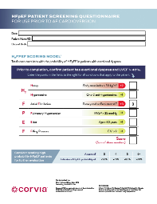
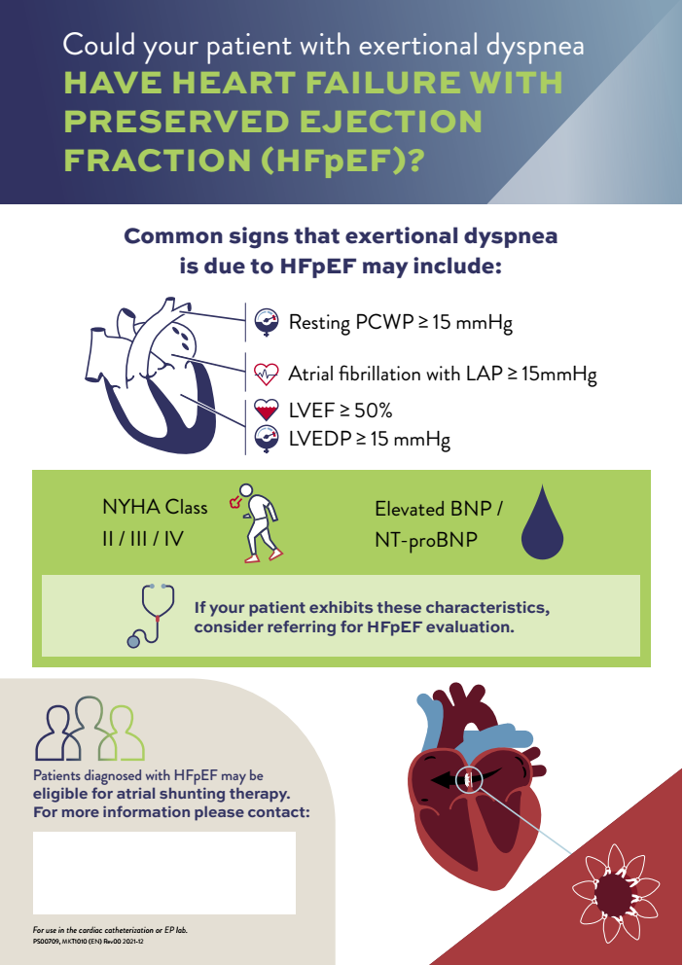


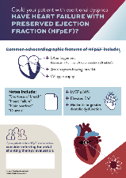
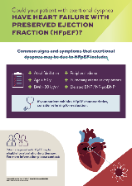


Recruitment tools: Accelerate enrollment
Tools to collaborate across hospital departments to Identify study candidates
Posters
(cath lab, echo, inpatient)
MD pocket card
Patient Identification Presentation
H2FPEF Scoring Tool
Video: Dr. Sanjiv Shah – Patient Talk Track

Slide 17






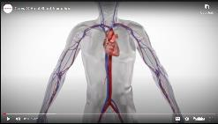

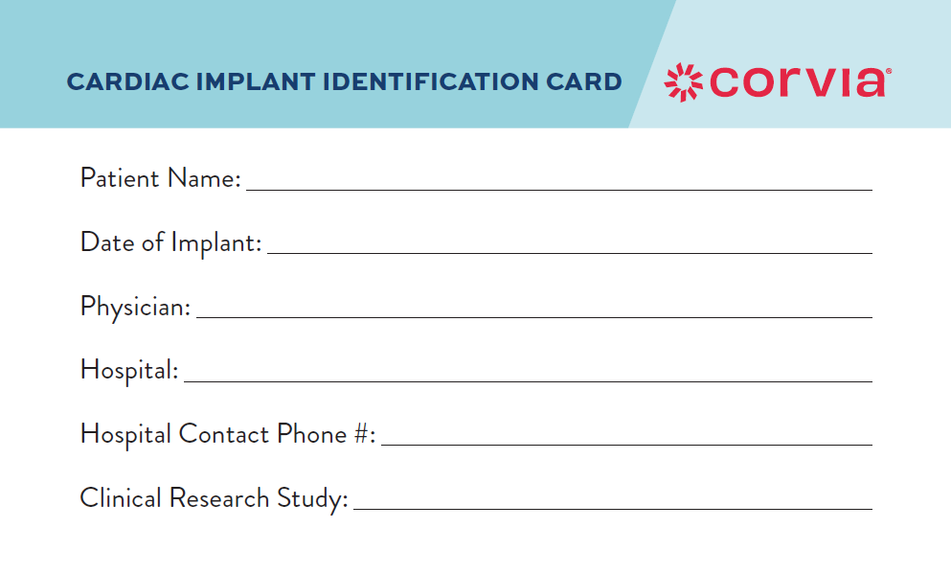
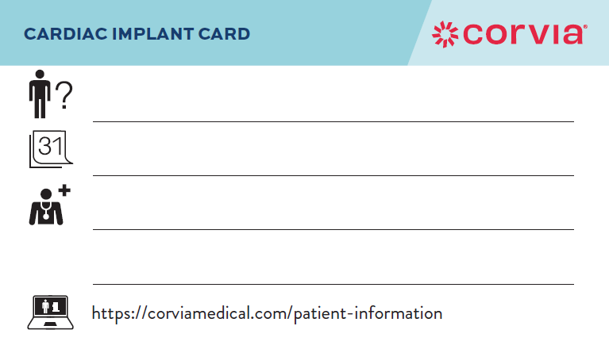
Recruitment tools: patient materials
Resources to educate patients throughout the study candidacy process
treatmyheartfailure.com
Patient Brochure
Patient Testimonial
(select geographies)
Doctor Discussion Guides
(based on potential trial eligibility)
Procedural Animation
Shunt Demo Cube
Patient ID Card (Blinded)

Slide 18

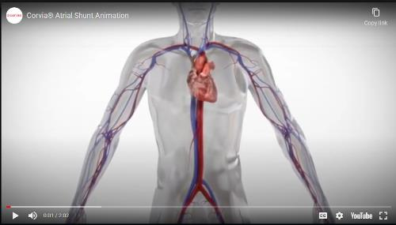




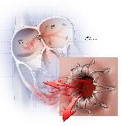

Awareness tools: PR resources
materials for media professionals
Corvia Medical Fact Sheet
RESPONDER-HF Trial Messaging
Images
Explainer animation
PR & social media templates

Slide 19




summary
Use HFpEF hotspots to find HFpEF patients. Refer suitable patients to study team.
Implement a standardized approach to find, diagnose, and treat HFpEF patients. This can improve patient outcomes and clinical efficiency.
Grow awareness of the HFpEF program to receive more referrals.
Screening potential candidates will benefit patients even if they don’t meet study criteria:
HFpEF diagnosis confirmed and patient qualifies -> patient goes into trial
HFpEF diagnosis confirmed but patient doesn’t qualify (PVD or other) -> patient placed in another HFpEF trial or treated with other therapy
HFpEF diagnosis NOT confirmed -> focus on other potential causes of shortness of breath

Slide 20
MKT1007 (short) Rev 00 2022-09
Corvia Shunt System® is a registered trademark of Corvia Medical, Inc. © 2022 Corvia Medical, Inc.

Slide 21
Tips for finding candidates by department

Slide 22

Finding hfpef patients among inpatients
Common signs that exertional dyspnea is due to HFpEF may include:
Atrial fibrillation
Age > 60 years
BMI > 30 kg/m²
History of hypertension
Peripheral / pulmonary edema
History of decompensation
“Heart failure” in notes
Elevated BNP / NT-proBNP
Use of IV diuretics
Unexplained dyspnea
H2FPEF Scoring Tool
Consider checking patient score when any of the signs are observed.
If a patient exhibits these characteristics, consider referring for evaluation for RESPONDER-HF.

Slide 23

Finding hfpef patients in the echo lab
Common echocardiographic signs that exertional dyspnea is due to HFpEF may include:
LA enlargement
(diameter >4 cm, or LA volume index >28 mL/m²)
Atrial septum bowing into RA
LV hypertrophy
LVEF ≥40%
Elevated E/e’
Moderate or greater diastolic dysfunction
Notes include:
“Shortness of breath”
“Heart failure”
“Fluid overload”
“Diuresis”
If a patient exhibits these characteristics, consider referring for evaluation for RESPONDER-HF.
Notes:
Patients referred by ED when they show up with decompensated HF
Patients referred by PCP because of dyspnea upon exertion
Want to ensure that a valve issue is not the cause of symptoms
LVEDP can now be estimated from echo (Joe will send paper)

Slide 24
Finding hfpef patients in the EP / CATH / cardioversion lab
Common signs that exertional dyspnea is due to HFpEF may include:
Resting LAP / PCWP
≥15 mmHg
(Exhibited by 70% of patients in prior study)
Exercise PCWP ≥25 mmHg
Atrial fibrillation
LVEF ≥50%*
NYHA Class II / III /
IV ambulatory
Elevated BNP / NT-proBNP
H2FPEF Scoring Tool
Consider checking patient score when any of the signs are observed. A score of 4 means >70% chance of HFpEF.
During PVI
Consider checking for LAP ≥15 mmHg after transseptal punch & after ablation.
During LH cath
Consider checking for LVEDP > 15 mmHg or coronary flow reserve (CFR) < 2.0, as HFpEF patients often have microvascular disease.
If a patient exhibits these characteristics, consider referring for evaluation for RESPONDER-HF.
*Patients with HFmrEF (LVEF 40-49%) also eligible for RESPONDER-HF

Slide 25
Finding hfpef patients in the pulmonology clinic
Common signs that exertional dyspnea is due to HFpEF may include:
Elevated systolic PA pressure / peak TR velocity on echo
(68% of increased PASP cases are due to HFpEF¹)
Stress test results (spiroergometry)
Mismatch between patient’s level of dyspnea & severity of COPD via spirometry
Mismatch between patient’s level of dyspnea & severity of PH
If a patient exhibits these characteristics, consider referring for evaluation for RESPONDER-HF.
¹Strange G, et al. Heart 2012

Slide 26
Finding hfpef patients in the obesity clinic
Common signs that exertional dyspnea is due to HFpEF may include:
Patient remains dyspneic despite months of attempting weight loss
Mismatch between patient’s level of dyspnea & severity of obesity
If a patient exhibits these characteristics, consider referring for evaluation for RESPONDER-HF.

