Slide 1
REDUCE LAP-HF II Trial: results summary
Strong Clinical Evidence Supporting Atrial Shunt Therapy in Heart Failure
MKT1015 Rev 01 2022-08

Slide 2
Reduce lap-hf II study design¹
phase III, multi-center, double-blind, Sham-controlled trial
PURPOSE: Evaluate the clinical efficacy and safety of the Corvia Atrial Shunt to improve quality of life and reduce HF related symptoms and events in patients with HFpEF or HFmrEF
Study Population
N = 626 randomized
Symptomatic HF, ongoing GDMT, age ≥40, LVEF ≥40%, preserved RV function, elevated exercise PCWP (≥25 mm Hg) with left-to-right gradient (≥ 5mmHg)
Atrial Shunt Treatment
N=314
PRIMARY ENDPOINT
Hierarchical composite of cardiovascular mortality or non-fatal, ischemic stroke through 12m, rate of total HF events (first and recurrent) through 24m & time to first HF event, change in KCCQ score between baseline & 12m
Sham Control
NN=312
SECONDARY ENDPOINTS
Composite safety endpoint (MACCRE)
Rate of HF admissions or IV diuresis, through 24m
Change in NYHA Class between baseline & 12m
Change in KCCQ score between baseline & 12m
¹Berry, N et al. Am Heart J, vol. 226 (2020): 222-231

Slide 3
Primary results
large Responder group identified Despite an overall neutral triaL
Primary Outcome
Primary Endpoint | Win Ratio¹ (95% CI) | p-Value
Composite Endpoint | 0.98 (0.8, 1.2) | 0.85
Responder Population
N=313
¹In win ratio calculation, all patients are compared with each other in pairwise manner on values of the components in a hierarchical manner (1 = neutral, >1 = treatment better, <1 = sham better)
50% of the study population benefited significantly from atrial shunt therapy…
Efficacy Endpoints | Treatment (N = 309)² | Control (N = 312) | p-Value
CV death or non-fatal ischemic stroke | 1% (4 events) | 1% (2 events) | 0.41
Cardiovascular Death | 1% (4 events) | 1% (2 events) | 0.65
Non-fatal Ischemic Stroke | <1% (1 event) | 0% (0 events) | 0.32
Total HF events per patient-year | 0.28 | 0.25 | 0.45
Change in KCCQ-OSS (Mean ± SD) | 11.5±22 | 10.5±21 | 0.73
Change in NYHA Class | -0.5 (-1.0, 0.0) | 0.0 (-1.0, 0.0) | 0.006
NEUTRAL
Non-Responder Population
N=313
…..while non-responders negatively impacted the overall result.
²Modified intention-to-treat population (excludes 5 patients who did not receive shunt device in active treatment arm)
Shah SJ et al. Lancet, 2022 Jan 31;S0140-6736(22)00016-2
Notes:
PVR
RAVI
Pacemakers
Right side health and lung inform post-hoc analysis

Slide 4

Primary Endpoint in responder group
Patients with Normal exercise PVR and no pacemaker derive significant HF and QoL benefit
Exclude high_{ex} PVR and pacemaker (50% of patients)
OVERALL COHORT (N=626)
RESPONDER GROUP
(N = 313)
Subgroup | Variable | Treatment (N=161) | Sham Control (N=152) | Win Ratio | P-Value
Peak PVR < 1.74, no pacemaker | Composite Endpoint (KCCQ Threshold=5) |  |  | 1.5 | 0.004
 | CV death or non-fatal ischemic stroke | 1.24% (2 events) | 0% (0 events) | - | 0.17
 | Total HF events per 100 patient-years | 12 | 22 | - | 0.034
 | Change in KCCQ-OSS [Mean ± SD] (N) | 15.5 ± 22.2 (153) | 10.0 ± 20.6 (141) | - | 0.027
Borlaug, BA et al. Circulation. 2022;145(21):1592-1604.
Notes:
.

Slide 5
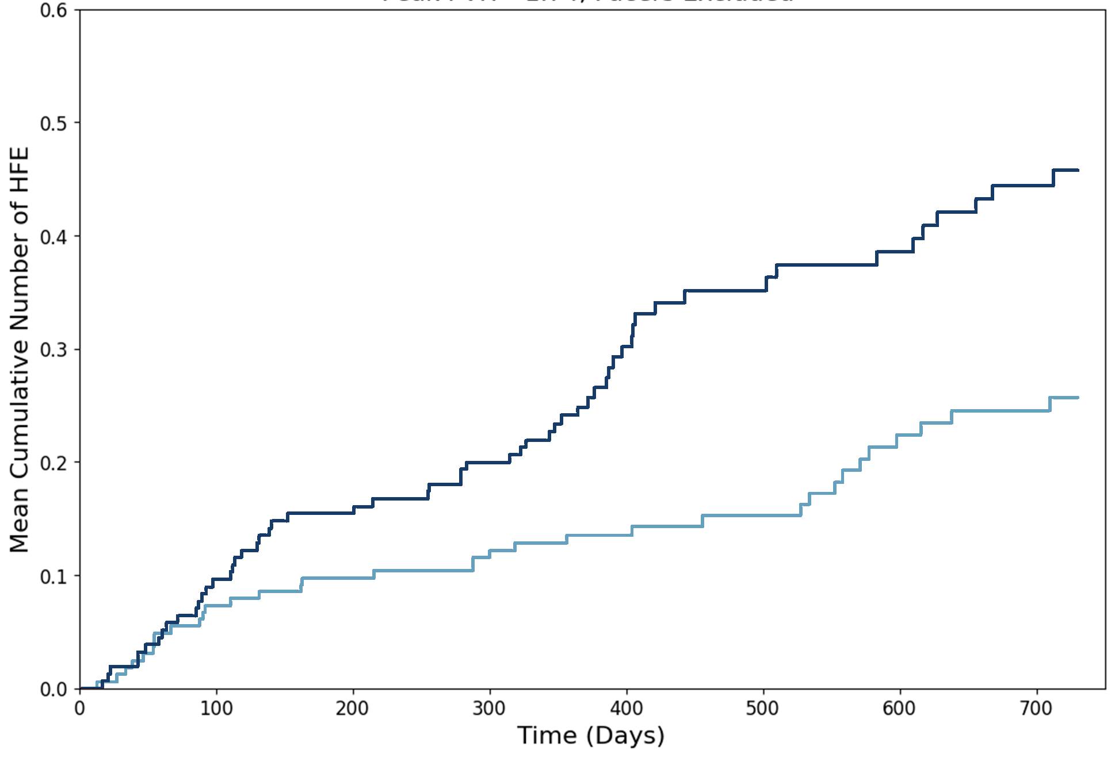
HF Events in Responder group
Significant reduction in total hf Events for treated patients
Shunt therapy led to a 45% reduction
in the rate of HF events
HF event curves separate early
and continue to diverge
Mean Cumulative HF Events
p = 0.034
P-value = 0.075
p = 0.075
Control
Mean cumulative number of HF events
3 months
Corvia Atrial Shunt
Treatment | At risk | 161 | 160 | 160 | 160 | 117 | 103 | 95 | 85
Control | At risk | 152 | 152 | 150 | 150 | 101 | 86 | 83 | 75
¹Through 12 months, and up to 24 months follow-up
REDUCE LAP-HF II 12-Month Primary Endpoint Report Addendum, Baim Institute 2022-01-18. Data on file at Corvia Medical.

Slide 6
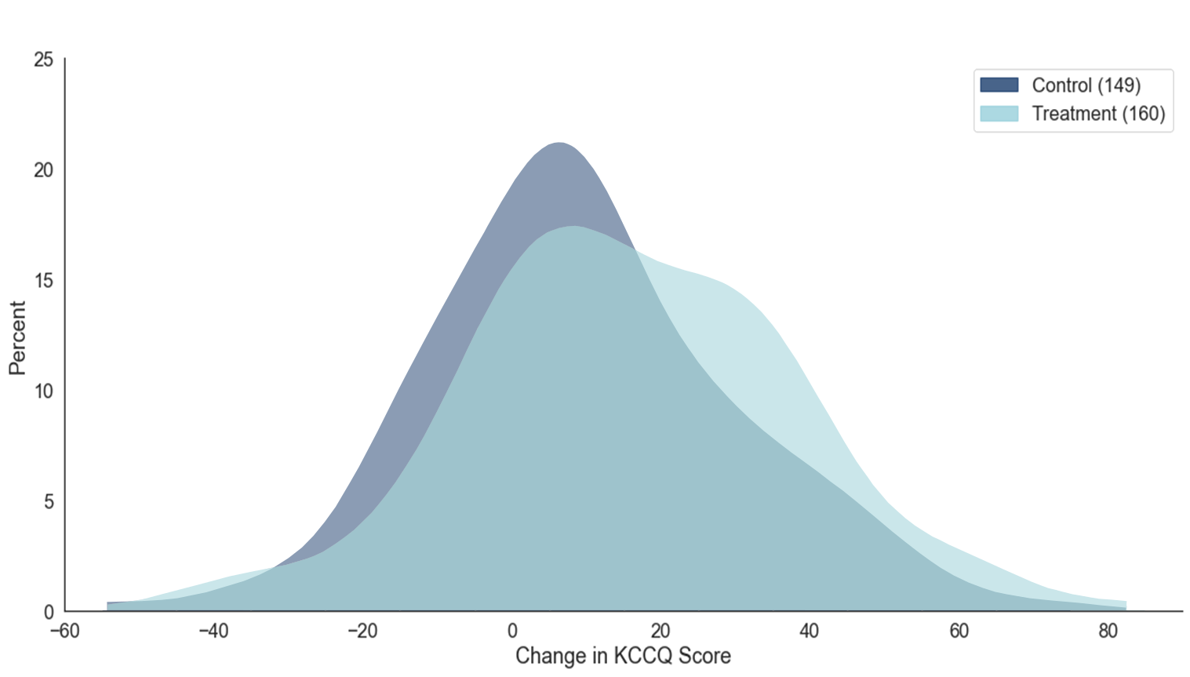
KCCQ-OSS in responder group
Clinically meaningful kccq improvement¹ at 12 months
Shunt patients had a
55% greater improvement in KCCQ
40% more shunt patients reported a very large improvement
(≥20 points) in KCCQ at 1 year vs. sham control
Distribution of KCCQ Change from Baseline
(N= 153)
p = 0.027
5.5 points*
(N=141)
% of patients
40% more shunt patients with marked improvement
Corvia Atrial Shunt
Sham control
*5.9 points difference after adjustment for baseline KCCQ
Worsened health status
Change in KCCQ score
Improved health status
¹A 5-point change in KCCQ OSS is considered clinically meaningful
REDUCE LAP-HF II 12-Month Primary Endpoint Report Addendum, Baim Institute 2022-01-18. Data on file at Corvia Medical.

Slide 7
NYHA Class & 6MWD in Responder Group
NHYA Class & 6-minute walk test congruent with HF and KCCQ Outcomes for Treated patients
Shunt therapy patients were over 40% more likely to improve to NYHA Class I/II
Shunt patients significantly improved 6MWD
p = 0.009¹
(N=137)
p = 0.04
Δ45%
Δ32%
(N=131)
Corvia Atrial Shunt
Sham control
Corvia Atrial Shunt
Sham control
¹Statistically significant difference between baseline and 12M for treatment vs control
REDUCE LAP-HF II 12-Month PER Addendum, Baim Institute 2022-01-18. Data on file at Corvia Medical.

Slide 8
Safety in responder group
no statistically significant safety risk versus SHAM control; INCREASE IN RV Size EXPECTED
Events through 12m | Corvia Atrial Shunt N=161 | Sham control N=152 | P-Value
Cardiovascular Mortality | 1/161 (0.62%) | 0/152 (0.00%) | 0.96
Non-fatal Ischemic Stroke | 1/161 (0.62%) | 0/152 (0.00%) | 0.96
New Onset or Worsening of Kidney Dysfunction | 12/161 (7.45%) | 16/152 (10.53%) | 0.34
MACE (Any MACE) | 3/161 (1.86%) | 0/152 (0.00%) | 0.95
Cardiac Death | 0/161 (0.00%) | 0/152 (0.00%) | -
Myocardial Infarction | 1/161 (0.62%) | 0/152 (0.00%) | 0.96
Cardiac Tamponade | 2/161 (1.24%) | 0/152 (0.00%) | 0.94
Emergency Cardiac Surgery | 0/161 (0.00%) | 0/152 (0.00%) | -
Thrombo-embolic Complications | 0/161 (0.00%) | 0/152 (0.00%) | -
Newly Acquired Persistent or Permanent AFib or Atrial Flutter | 3/161 (1.86%) | 2/152 (1.32%) | 0.7
≥30% Increase in RV Size and/or Decrease in TAPSE | 56/161 (34.78%) | 32/152 (21.05%) | 0.01
≥30% Increase in RV Size | 54/161 (33.54%) | 30/152 (19.74%) | 0.01
≥30% Decrease in TAPSE | 3/161 (1.86%) | 3/152 (1.97%) | 0.94
REDUCE LAP-HF II 12-Month Primary Endpoint Report Addendum, Baim Institute 2022-01-18. Data on file at Corvia Medical.
Notes:
Source: Table 2a Baim report
Note: Increase in RV size and decrease in TAPSE don’t add up to total; one treatment subject and one control subject had both ≥30% Increase in RV Size and ≥30% Decrease in TAPSE, thus the # in the last 3 rows don’t add up

Slide 9
REDUCE LAP-HF ii summary
REDUCE LAP-HF II is the largest device therapy trial in HFpEF, addressing the biggest unmet need in cardiology
The study has significantly advanced the understanding of patient selection, and we are now able to clearly identify potential responders, which represent >50% of the trial population
Patients with normal exercise pulmonary vascular resistance (PVR <1.74) and without a pacemaker derived significant clinical benefit from the shunt
  45% reduction in the rate of HF events (12 vs. 22 events per 100 patient-years, p = 0.007)
  55% greater improvement in health status over sham as assessed by KCCQ overall summary score (+5.5 points, p = 0.027) , including 40% more patients with a very large (>20 points) quality of life improvement
The responder group makes strong pathophysiologic sense and is supported by congruence in clinical outcomes, including a reduction in the HF event rate and an improvement in health status (both KCCQ and NYHA class)
Exercise hemodynamic phenotyping plays a critical role in appropriate patient selection
RESPONDER-HF, a confirmatory, randomized trial in the responder population is expected to begin Q3 ‘22

Slide 10
MKT1015 Rev 01 2022-08
Corvia Shunt System® is a registered trademark of Corvia Medical, Inc.
© 2022 Corvia Medical, Inc.

